Slide 1
Chapter 3
Managing Systems Projects

Slide 2
Learning Objectives (1 of 2)
After this chapter, you will be able to:
Illustrate project priorities in the form of a project triangle
Explain project planning, scheduling, monitoring, and reporting
Create a work breakdown structure
Identify task patterns
Calculate a project’s critical path
Describe project monitoring and control techniques to keep a project on schedule

Slide 3
Learning Objectives (2 of 2)
Explain how project status is reported
Describe project management software and how it can be of assistance
Create a risk management plan
Describe why projects sometimes fail

Slide 4
Overview of Project Management (1 of 3)
Project management
Planning, scheduling, monitoring and controlling, and reporting on information system development
What shapes a project?
Successful projects must be completed on time, within budget, meet requirements, and satisfy users

Slide 5
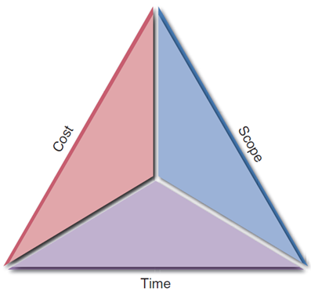
Overview of Project Management (2 of 3)
What is a project triangle?
Challenge: find optimal balance among the factors
Any change in one leg will affect the other legs
FIGURE 3-2 A typical project triangle includes cost, scope, and time.

Slide 6
Overview of Project Management (3 of 3)
What does a project manager do?
Project planning: identifying all project tasks and estimating completion time and costs
Project scheduling: creating a specific timetable showing tasks, task dependencies, and critical tasks that might delay the project
Project monitoring: guiding, supervising, and coordinating the project team’s workload
Project reporting: creating regular progress reports for management, users, and the project team itself

Slide 7
Creating a Work Breakdown Structure (1 of 8)
Breaking down a project into a series of smaller tasks
Gantt Chart
Horizontal bar chart representing a set of tasks
Shows planned and actual progress on a project
Simplifies complex projects using a task group

Slide 8
Creating a Work Breakdown Structure (2 of 8)
PERT/CPM charts
Program Evaluation Review Technique (PERT)
Developed by the U.S. Navy
Utilizes a bottom-up technique
Useful for scheduling, monitoring, and controlling actual work
Displays complex task patterns and relationships
Critical Path Method (CPM)
Developed by private industry

Slide 9
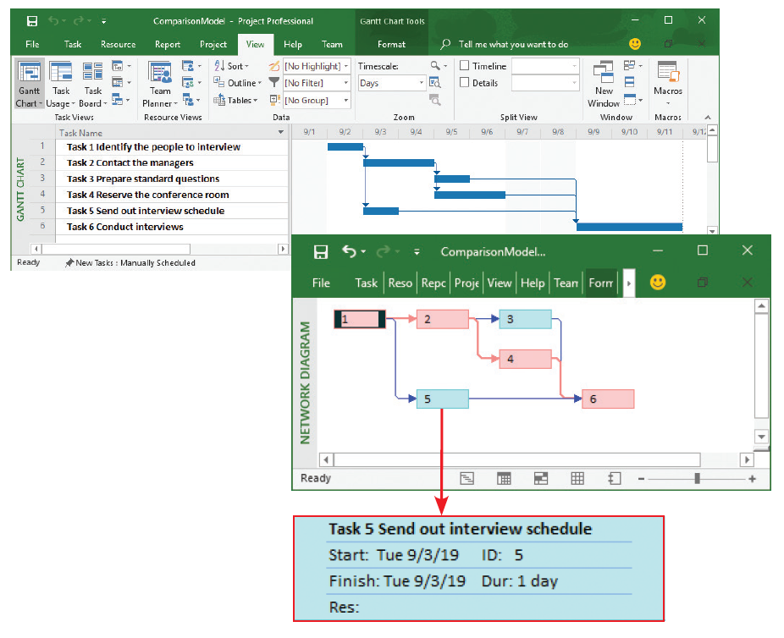
Creating a Work Breakdown Structure (3 of 8)
FIGURE 3-4 The top screen shows a Gantt chart with six tasks. The PERT chart in the bottom screen displays an easy-to-follow task pattern for the same project. When the user mouses over the summary box for Task 5, the details become visible.

Slide 10
Creating a Work Breakdown Structure (4 of 8)
Identifying tasks in a WBS
Task or activity: any work that has a beginning and end
Requires the use of company resources such as people, time, or money
Should be small and manageable
Projects have events or milestones
Events or milestones: recognizable reference points used to monitor progress

Slide 11
Creating a Work Breakdown Structure (5 of 8)
Listing the tasks
Tasks might be embedded in a document
Estimating task duration
Can be hours, days, or weeks
Time estimates made by project managers
Best case-estimate (B), probable-case estimate (P), and worst-case estimate (W)
After making estimates, the manager assigns a weight to each estimate
Calculates the task duration

Slide 12
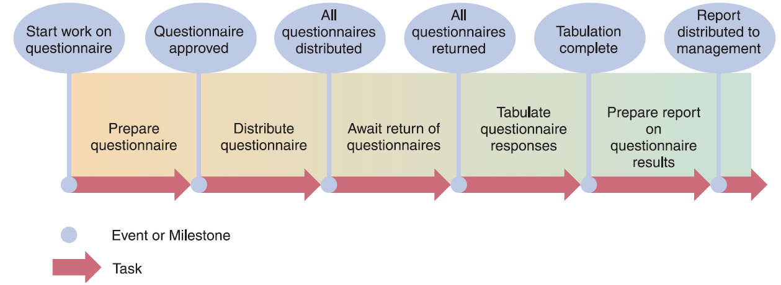
Creating a Work Breakdown Structure (6 of 8)
FIGURE 3-5 Using a questionnaire requires a series of tasks and events to track the progress. The illustration shows the relationship between the tasks and the events, or milestones, that mark the beginning and end of each task.

Slide 13
Creating a Work Breakdown Structure (7 of 8)
Factors affecting duration
Project size
Identify all project tasks and time required
Consider time taken for events affecting productivity
Human resources
Assemble and guide a development team that has the skill and experience to handle the project
Deal with factors that could affect the schedule

Slide 14
Creating a Work Breakdown Structure (8 of 8)
Experience with similar projects
Develop time and cost estimates based on the resources used for similar, previously developed information systems
Constraints
Define system requirements that can be achieved realistically within the required constraints

Slide 15
Task Patterns (1 of 6)
Arrangement of tasks in a logical sequence
Dependent tasks
Multiple successor tasks
Multiple predecessor tasks

Slide 16
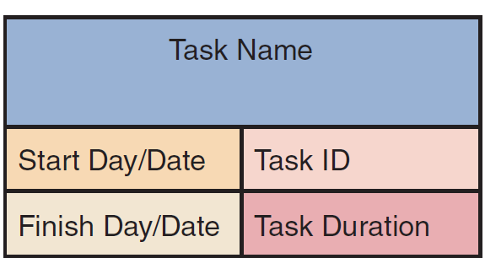
Task Patterns (2 of 6)
Using task boxes to create a model
FIGURE 3-10 Each section of the task box contains important information about the task, including the Task Name, Task ID, Task Duration, Start Day/Date, and Finish Day/Date.

Slide 17
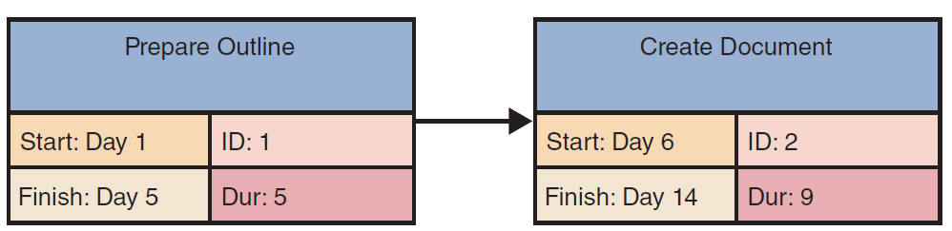
Task Patterns (3 of 6)
Dependent tasks
Completed in a sequence
One task can be initiated only after the prior task has been completed
FIGURE 3-12 This example of a dependent task shows that the finish time of Task 1, Day 5, controls the start date of Task 2, which is Day 6.

Slide 18
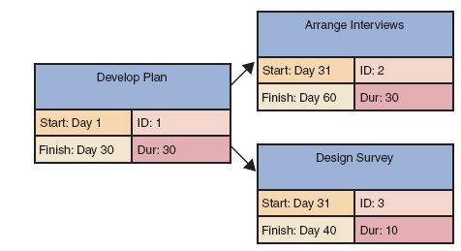
Task Patterns (4 of 6)
Multiple successor tasks
Tasks that can be initiated simultaneously
Termed concurrent
Often, two or more concurrent tasks depend on a predecessor task
FIGURE 3-13 This example of multiple successor tasks shows that the finish time for Task 1 determines the start time for both Tasks 2 and 3.

Slide 19
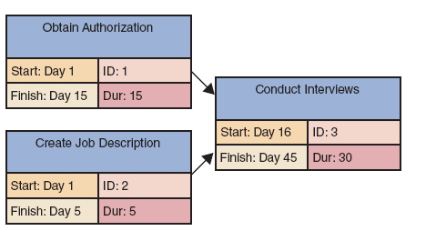
Task Patterns (5 of 6)
Multiple predecessor tasks
Initiation of a task depends on completion of two or more prior tasks
FIGURE 3-14 This example of multiple predecessor tasks shows that the start time for a successor task must be the latest (largest) finish time for any of its preceding tasks. In the example shown, Task 1 ends on Day 15, while Task 2 ends on Day 5, so Task 1 controls the start time for Task 3.

Slide 20
Task Patterns (6 of 6)
Working with complex task patterns
When several task patterns combine, the facts must be studied very carefully to understand the logic and sequence
A project schedule will not be accurate if the underlying task pattern is incorrect

Slide 21
The Critical Path (1 of 3)
Series of tasks which, if delayed, will affect the completion date of the overall project
If any task on the critical path falls behind schedule, the entire project will be delayed
Calculating the critical path
Review patterns
Determine start and finish dates, which will define the critical path

Slide 22
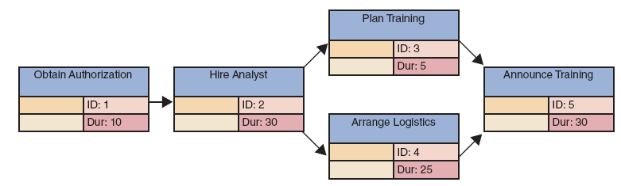
The Critical Path (2 of 3)
FIGURE 3-18 Example of a PERT/CPM chart with five tasks. Task 2 is a dependent task that has multiple successor tasks. Task 5 has multiple predecessor tasks. In this figure, the analyst has arranged the tasks and entered task names, IDs, and durations.

Slide 23
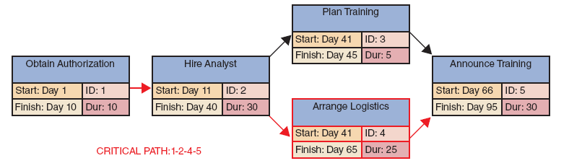
The Critical Path (3 of 3)
FIGURE 3-19 Now the analyst has entered the start and finish times, using the rules explained in this section. Notice that the overall project has a duration of 95 days.

Slide 24
Project Monitoring and Control (1 of 2)
Monitoring and control techniques
Structured walk-through: review of a project team member’s work by other team members
Takes place throughout the SDLC
Known as design, code, or testing reviews based on the phase in which they occur

Slide 25
Project Monitoring and Control (2 of 2)
Maintaining a schedule
Projects run into problems or delays
Projects managers monitor and control work
Anticipate problems, avoid them, and minimize impact
Identify potential solutions and select the best way to solve the problem
Tasks and the critical path
Project managers spend most of their time tracking the tasks along the critical path

Slide 26
Reporting
Project status meetings
Project managers schedule regular meetings
Share updates, discuss common problems, explain new techniques, and help collect data
Project status reports
Regularly communicated by project managers to supervisors, upper management, or users
Dealing with problems
Deciding how to handle problems can be difficult

Slide 27
Project Management Software (1 of 2)
Project managers use software applications to help plan, schedule, monitor, and report on a project
Most programs offer features such as PERT/CPM, Gantt charts, resource scheduling, project calendars, and cost tracking

Slide 28
Project Management Software (2 of 2)
Refer to the text for a Microsoft Project task summary example
Work breakdown structure
Gantt chart
Network diagram
Calendar view

Slide 29
Risk Management
Steps in risk management
Develop a risk management plan
Identify the risks
Analyze the risks
Qualitative and quantitative risk analysis
Create a risk response plan
Proactive effort to anticipate a risk and describe an action plan to deal with it
Monitor risks

Slide 30
Managing for Success
Project management is a challenging task
Project managers must be alert, technically competent, and highly resourceful
Projects get derailed for a wide variety of reasons
Business issues
Budget issues
Schedule issues

Slide 31
Summary (1 of 3)
Project management
Planning, scheduling, monitoring, and reporting on the development of an information system
Project triangle
Shows three legs that require balancing
Project cost, scope, and time

Slide 32
Summary (2 of 3)
Planning, scheduling, monitoring, and reporting
Take place within a larger development framework
Creating a work breakdown structure
Identifying task patterns
Calculating the critical path
Task patterns establish the sequence of work in a project
A critical path is a series of tasks that, if delayed, would affect the completion date of the overall project

Slide 33
Summary (3 of 3)
Gantt chart: horizontal bar chart
Represents the project schedule with time on the horizontal axis and tasks arranged vertically
PERT/CPM chart: network diagram
Tasks connected by arrows
Most project managers use powerful software to plan, schedule, and monitor projects
Microsoft Project

